Slide 1

Welcome

Slide 2
Presented by:
Name | ID
1
2
3
4
Annysha Huzzat | 011 171 034
Hasin Kawsar Jahan | 011 171 054

Slide 3
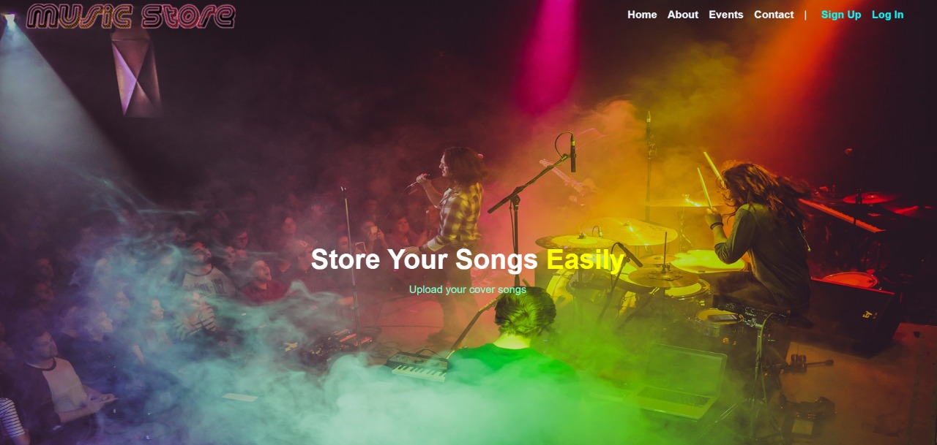
# Music Store

Slide 4





Here we got 5 website

Slide 5
Language list
Radio
Trending songs
Mood selection (like Sufi, Ghazals, Old Hindi etc)
Download
Share
Own favorites, playlist, album
Watch shows

Slide 6
Available for desktop and mobile device
Distribution of artists’ work for free (accessible by all users)
Trending tracks and playlists
Like, Repost, Share, Follow, comment
Upload music and download
Supports several audio file format standards , then transcodes into mp3
Supports CC license

Slide 7
Night mode
Movie and video support
Kid section
Mobile apps
Earn coin and get rewards
Buy pro plans
Search

Slide 8
Next ……

Slide 9
Go Pro
Song suggestions
Radio station
Android , ISO and windows apps
Top 15 songs (weekly)
Surprise me
Own favorites, playlist, songs

Slide 10
Shuffle play
Download
Radio
Daily mix
Lyrics
Queues & History
Watch- videos, concerts
Library

Slide 11

Upload songs
Download songs
Rate and comment
Report and review
Request for new songs
Favorite playlist
Admin panel

Slide 12
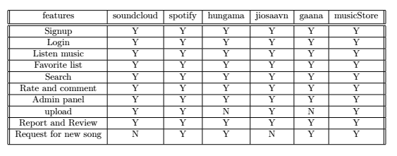
Comparison

Slide 13
Next ……

Slide 14
Feasibility:
Guest Mode
Request for a song
Shuffle play from playlist
Add song genre
Track history or activities
Report a song
Playlist for different moods
Rate and Comment to a song

Slide 15
Marking :
option 1 : Very Bad / Absolutely not / Not at all
option 2 : Bad / no
option 3 : I don't care / maybe
option 4 : Good / yes
option 5 : Very good / I'd love it / That'd be great / Very helpful

Slide 16
Threshold
Set about 3.5

Slide 17
Next ……

Slide 18
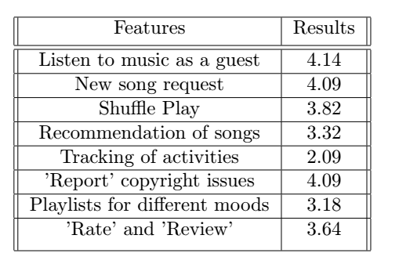
Results:

Slide 19
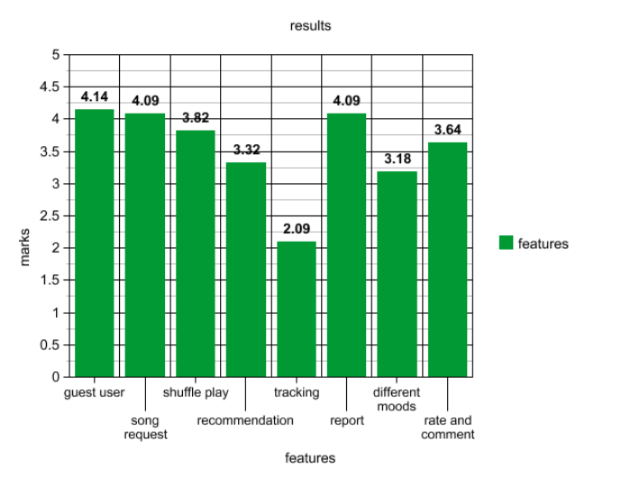
Results:

Slide 20
Threshold
Set about 3.5

Slide 21
We provide
update feature
signup
login
Listen music
Favorite list
Search
Rate and comment
Admin panel
Review and report
Request for new song

Slide 22
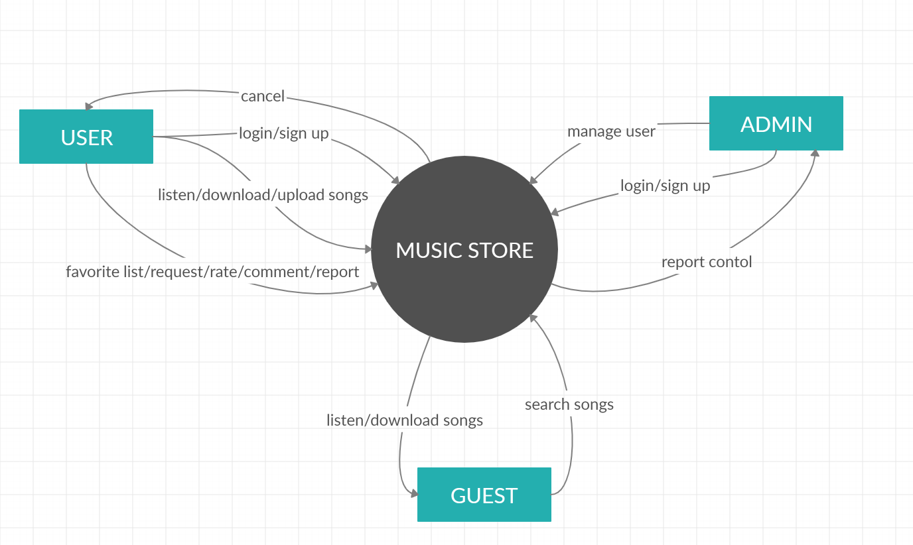
Data flow diagram : Context level

Slide 23
Next ……

Slide 24
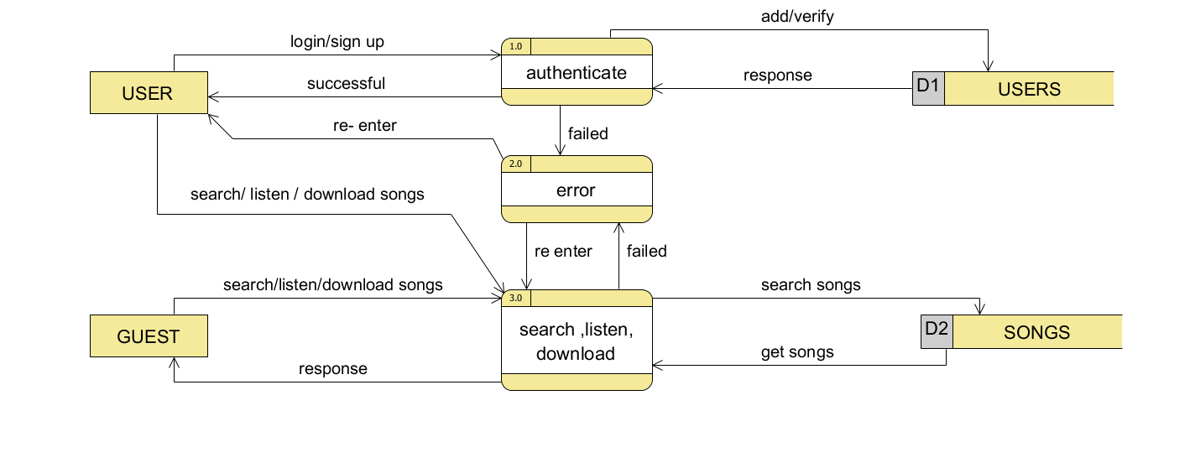
Data flow diagram

Slide 25
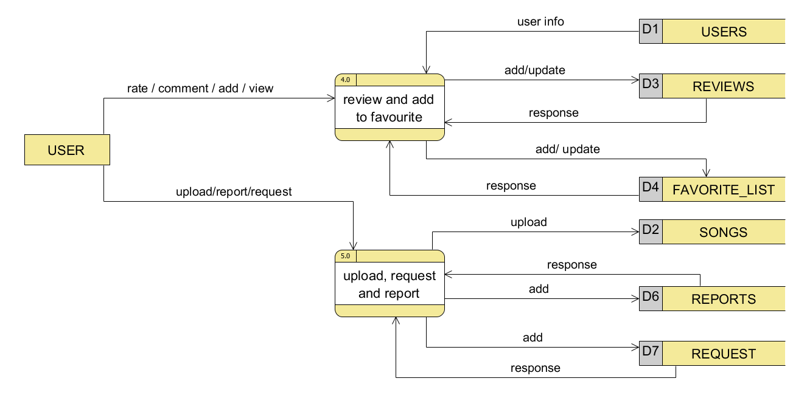
Data flow diagram

Slide 26
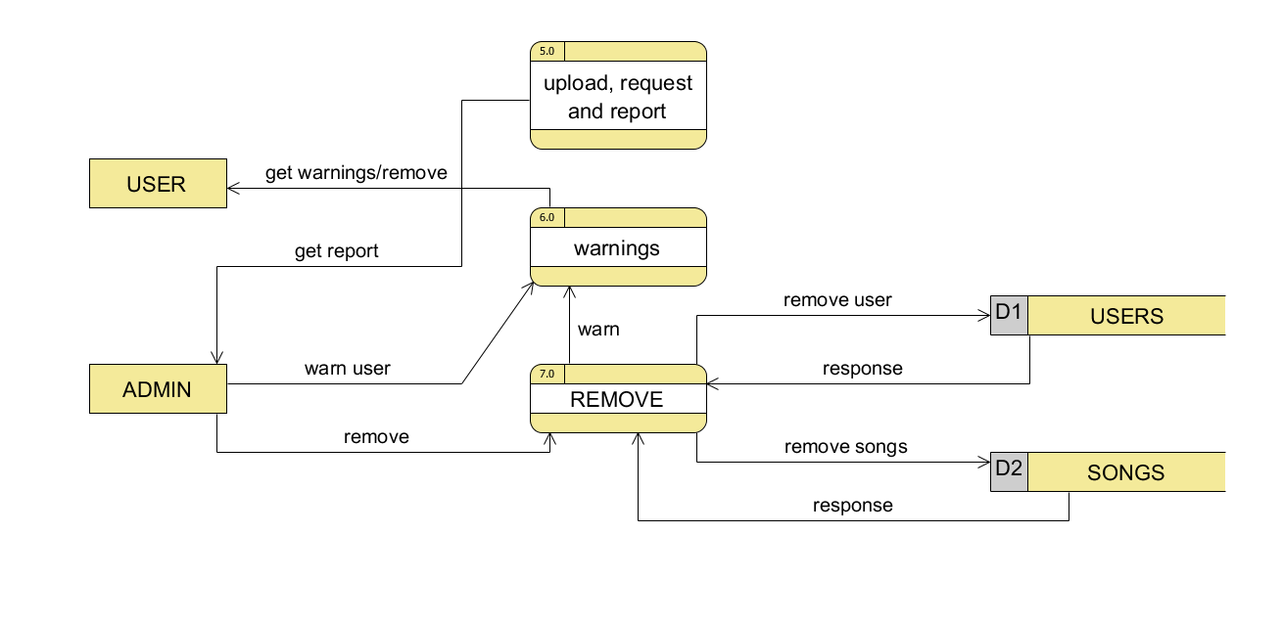
Data flow diagram

Slide 27
Next ……

Slide 28
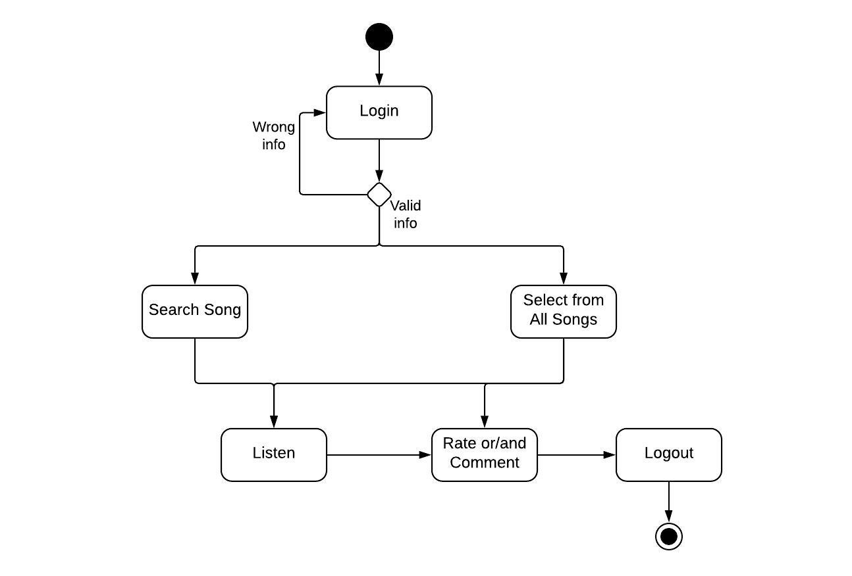
Activity diagram

Slide 29
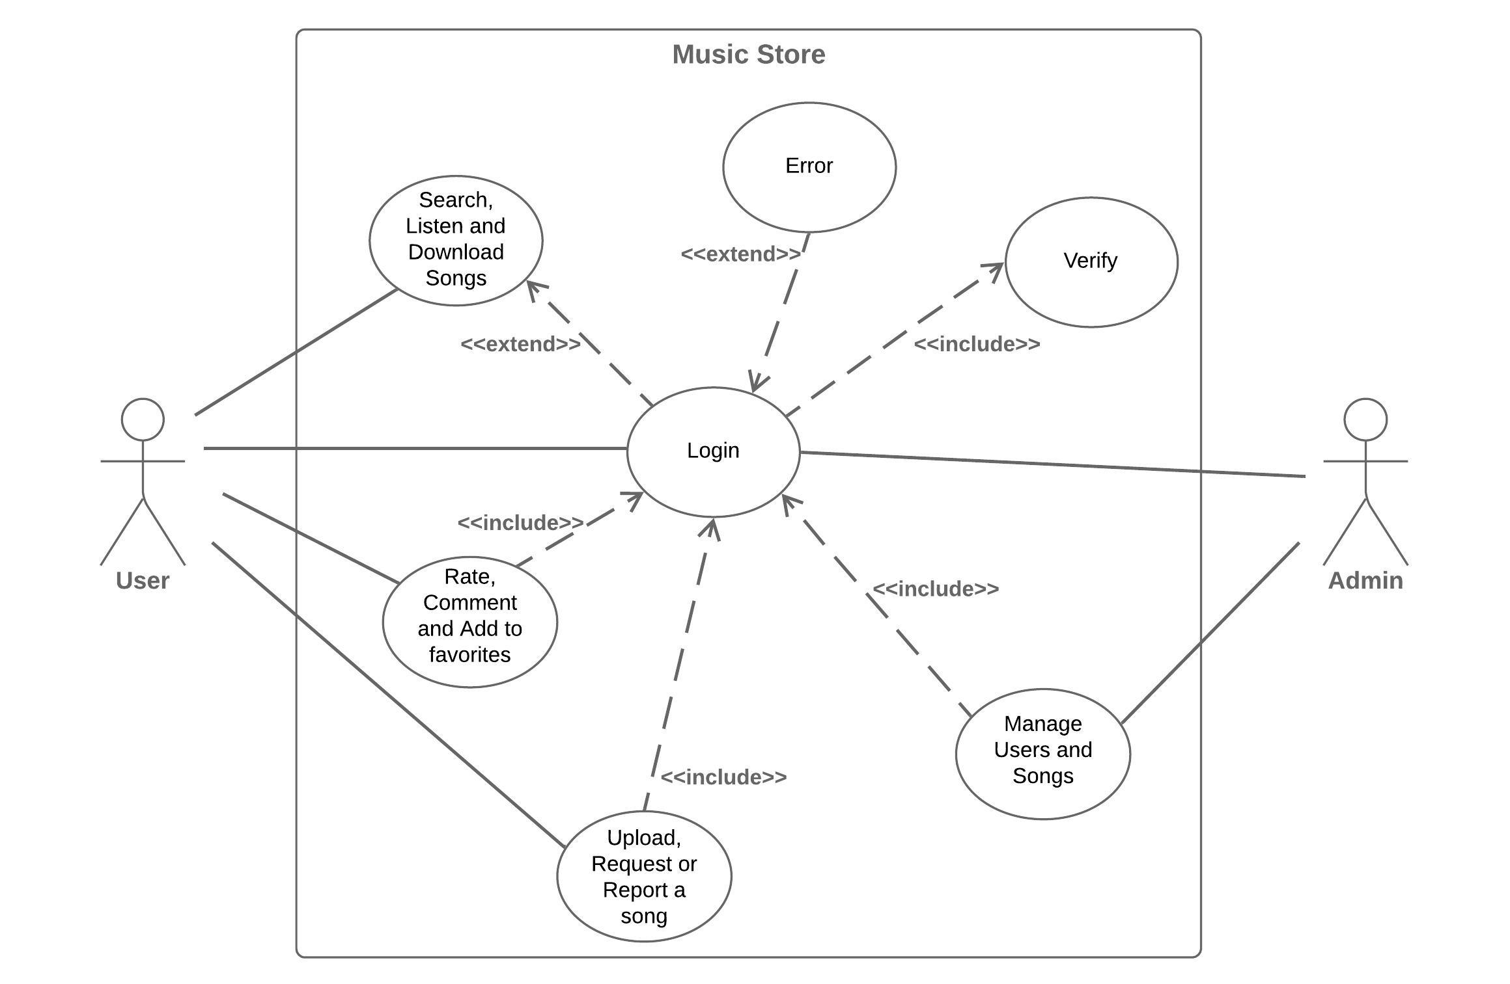
Use case diagram

Slide 30
Use case (descriptive)
Use Case 01: Upload a Song
Primary Actor: User
Stakeholders and Interests:
User: Wants to successfully upload a song
Admin: Has to maintain copyright issues
Pre conditions:
The user should be authorized
User should know the correct username and password
The song to be uploaded should be in the device already

Slide 31
Use case (descriptive contd.)
Success scenario:
User goes to the website.
User logs into the system using correct username and password
User clicks the ‘Upload songs’ button
User selects a song from the device
User uploads the song

Slide 32
Use case (descriptive contd.)
Alternate scenario:
*a. The system may not respond
Solution: Wait for the system to respond
4a. The user might not find the desired song to upload
Solution: The user has to copy the song to the device first
5a. The format of the audio file may not be supported by the website
Solution: The user must convert the file to the format required

Slide 33
Use case (descriptive contd.)
Post conditions:
The song is available in the website for other users
The song is stored in database
The admin can remove the song if copyrighted
Issues:
If username or password is not correct, error message is displayed

Slide 34


